Slide 1
DISCUSSION SECTION
WEEK 3
EXAM 01 REVIEW

Slide 2
The Command Line
ls: list the contents of the current directory
cd: change the current directory
pwd: print the current working directory
mkdir: make a new directory
rmdir: delete an empty directory
rm –r: delete a non-empty directory
touch: create a new file
rm: delete a file
cp: copy a file
mv: move a file cat: concatenate and display file contents

Slide 3
Exercises
What command would you use to create a new directory called project-1?
How would you move into the project-1 directory?
What command would you use to create a new file called index.html?
How might you rename index.html to home.html?
What command would you use to list the contents of the current directory, including the hidden ones?
Notes:
mkdir project-1
cd project-1
touch index.html
mv index.html home.html
ls -a

Slide 4
Number Systems
Decimal to Binary: You can use the following algorithm
Divide the decimal number by 2
Get the integer quotient for the next iteration
Get the remainder for the binary digit
Repeat the steps until the quotient is equal to 0
The binary number is the remainder read from bottom to top
Example: To convert the decimal number 10 to binary:
10 / 2 = 5 remainder 0
5 / 2 = 2 remainder 1
2 / 2 = 1 remainder 0
1 / 2 = 0 remainder 1 Therefore, the binary of 10 is 1010

Slide 5
Number Systems
Binary to Decimal: To convert a binary number to decimal, you can use the following formula
d = (b₀ x 2⁰) + (b₁ x 2¹) + (b₂ x 2²) + … + (b_{n} x 2^{n})
..where d is the decimal number and b₀, b₁, b₂,…,b_{n} are the binary digits read backwards

Slide 6
Number Systems
Hexadecimal to Decimal: To convert a hexadecimal number to decimal, you can use the following formula
d = (h₀ x 16⁰) + (h₁ x 16¹) + (h₂ x 16²) + … + (h_{n} x 16^{n})
..where d is the decimal number and h₀, h₁, h₂,…,h_{n} are the hexadecimal digits read backwards

Slide 7
Number Systems
Decimal to Hexadecimal: You can use the following algorithm
Divide the decimal number by 16
Get the integer quotient for the next iteration
Get the remainder for the hexadecimal digit. If the remainder is greater than 9, use the corresponding letter (A, B, C, D, E, F)
Repeat the steps until the quotient is equal to 0
The hexadecimal number is the remainder read from bottom to top
Example: To convert the decimal number 200 to hexadecimal:
200 / 16 = 12 remainder 8
12 / 16 = 0 remainder 12
Therefore, the hexadecimal of 200 is C8

Slide 8
Exercises
Convert the decimal number 42 to a binary number.
Convert the binary number 101101 to a decimal number.
Convert the decimal number 255 to a hexadecimal number.
Convert the hexadecimal number 1A3 to a decimal number.
Notes:
1. 101010
2. 45
3. FF
4. 419

Slide 9
True or False?
1. C++ programs may not include a main function
2. The std::cout object is used to read user input
3. break can be used to exit a function prematurely
4. The default case in a switch statement is mandatory
in C++
5. In C++, you can declare a function inside another
function
6. Predefined functions can be invoked after including the library header
Notes:
1. false
2. false
3. false
4. false
5. false
6. true

Slide 10
True or False?
include <iostream>
int main( ) {
int x = 5;
int y = 0;
std::cout << x / y << std::endl;
}
T or F: The above code will compile successfully
Notes:
Yes! this division by zero is a runtime error, therefore the compiler will not catch it at compile-time.

Slide 11
Expected Output?
include <iostream>
int main( ) {
int x = 3;
do {
std::cout << "Exam Prep" << std::endl;
x++;
} while (x < 3);
}
How many times will "Exam Prep" print?
Notes:
Once! Cuz do-while loop executes code block at least once before checking condition.

Slide 12
What’s the Output? #include <iostream>
int func(int x, int y) {
int temp = x;
x = y;
y = temp;
return temp - y;
}
int main( ) {
int x = 5, y = 2;
x = func(y, x);
std::cout << func(x, y);
}
Notes:
Answer is Zero! Use pythontutor.com to visualize code trace.

Slide 13
What’s the Output?
#include <iostream>
int main( ) {
int a = 5;
int b = 10;
if (a > b) {
if (a > 0) {
std::cout << "A is greater than B and positive";
}
else {
std::cout << "B is greater than A";
}
}
}
Notes:
No output! Use pythontutor.com to visualize code trace.

Slide 14
What’s the Output? #include <iostream>
int func1(int x) {
return x + 5;
}
int func2(int y) {
y *= 2;
return func1(y + 3);
}
int main( ) {
int x = 3, y = 2;
std::cout << func2(x) + func1(y);
}
Notes:
Answer is 21! Use pythontutor.com to visualize code trace.

Slide 15
What’s the Output?
#include <iostream>
int main( ) {
int i = 3, j = 4; int k = ++i + ++j;
k += i++ + j++;
i = k++ + ++j;
std::cout << i << " " << j << " " << k;
}
Notes:
25 7 19

Slide 16
What does this mystery function do?
#include <iostream>
int mysteryFunction(int x) {
int result = 0; while(x > 0) {
result += x % 10;
x /= 10;
}
return result;
}
Notes:
Sums up all digits of a number. For example, if number = 123, then result = 6

Slide 17
What does this mystery function do?
#include <iostream>
int mysteryFunction(int x) {
int result = 1; for(int i= 2; i <= x; i++) {
result *= i;
}
return result;
}
Notes:
Calculates factorial of a number! for x = 3, result = 6.

Slide 18
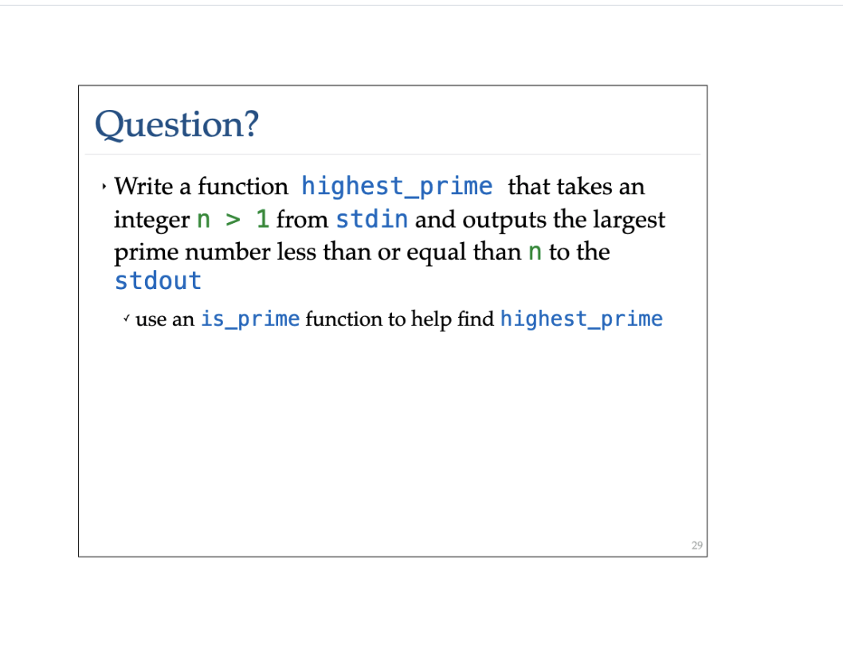
Notes:
int highest_prime(int n) {
for (int i = n; i > 1; i--) {
bool isPrime = true;
for (int j = 2; j <= i/2; j++) {
if (i % j == 0) {
isPrime = false;
break;
}
}
if (isPrime) return i;
}
}
int main() {
std::cout << highest_prime(32);
return 0;
}

